Slide 1
3D Face Recognition Project Report
Mouqing Jin
04/23/2018
Multimedia Computing & Communication Lab

Slide 2
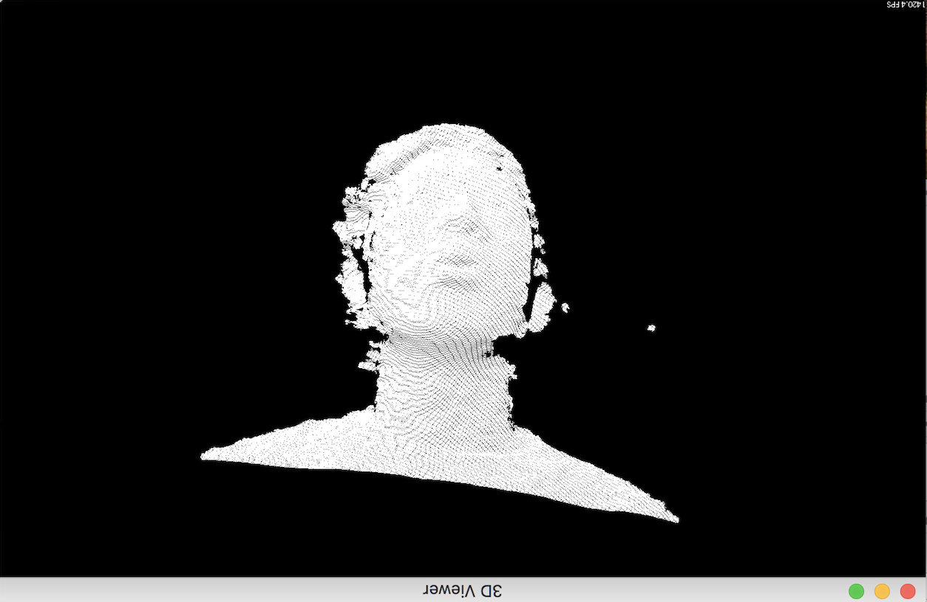
PCL Clipper
Find the head boundary in the point cloud.
Set the min_x, max_x, min_y, max_y, min_z, and max_z to clip the face data from the whole Point Cloud data.
Multimedia Computing & Communication Lab

Slide 3
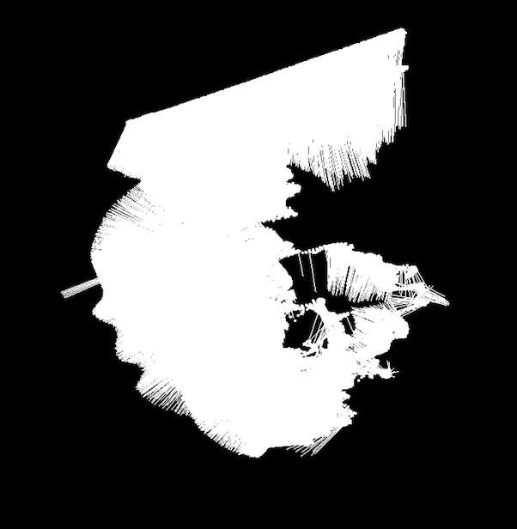
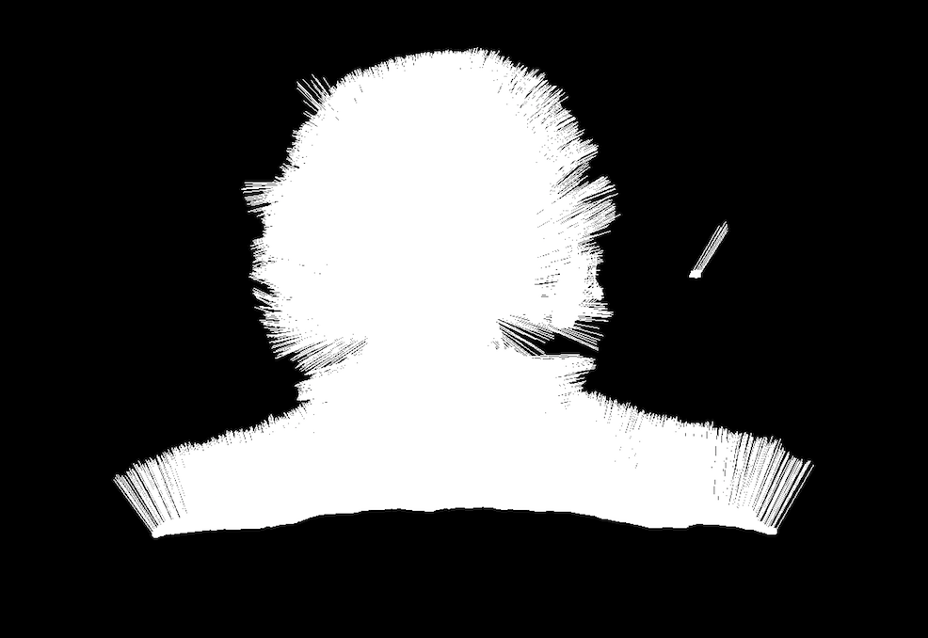
Estimating Surface normal
Surface normals are important properties of a geometric surface
Surface normals are heavily used in many areas such as computer graphics applications and computer feature histogram.
Multimedia Computing & Communication Lab

Slide 4
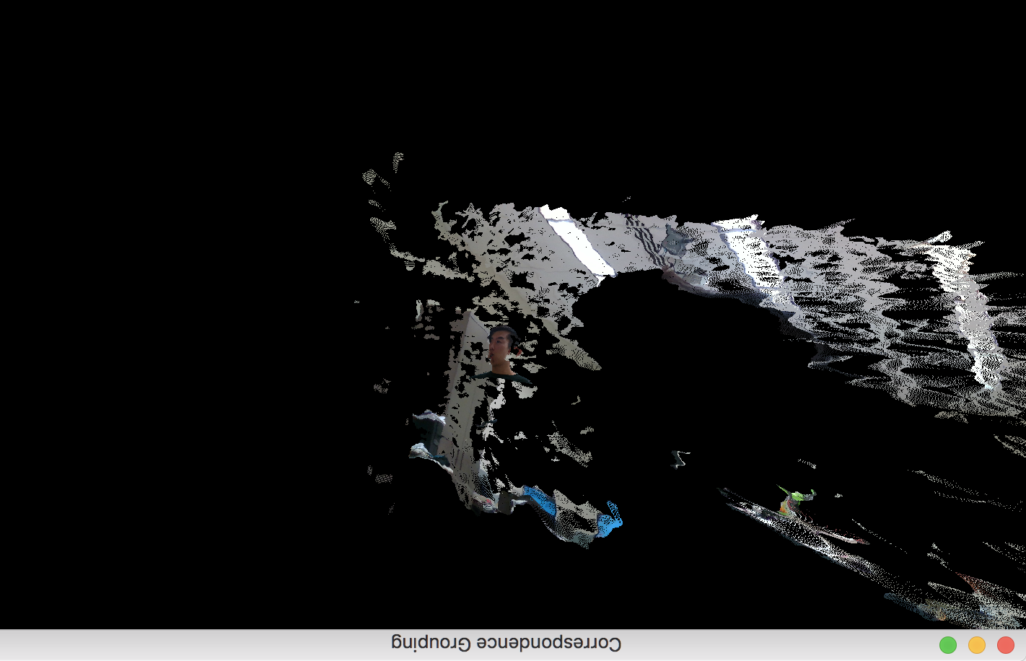
3D Object Recognition
Using Correspondence Grouping algorithms
the 3D descriptor matching stage into model instances that are present in the current scene
Find face model in current scene
Current scene
Multimedia Computing & Communication Lab

Slide 5
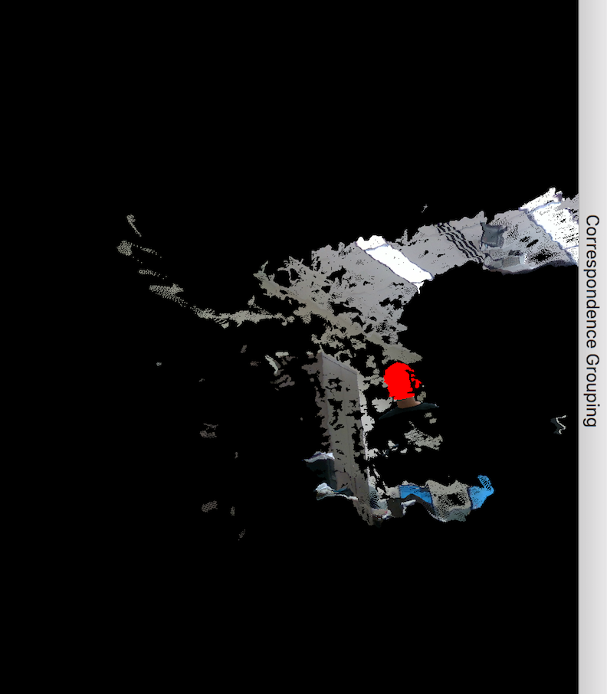
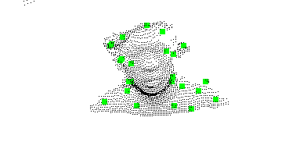
3D Object Recognition
Main step:
Compute Normals
Downsample Clouds to Extract keypoints
Compute Descriptor for keypoints
Find Model-Scene Correspondences with KdTree
find nearest neighbor into the model keypoints descriptor
add it to the correspondences vector
Actual Clustering
Face model
Find face model in scene
Multimedia Computing & Communication Lab

Slide 6
Thank you!

